Slide 1

Christopher B. Barrett, Cornell University
Seminar at Stanford University
Center on Food Security and the Environment
February 26, 2020
Innovations Needed to Meet Global Food Security Challenges

Slide 2

Why should we care?
Food security is a human right (Art. 25 1948 UDHR), intrinsic to human flourishing
Food security exists if and only if
“all people at all times have physical, social, and economic access to sufficient, safe and nutritious food that meets their dietary needs and food preferences for an active and healthy life”
(1996 World Food Summit definition, emphasis added)

Slide 3
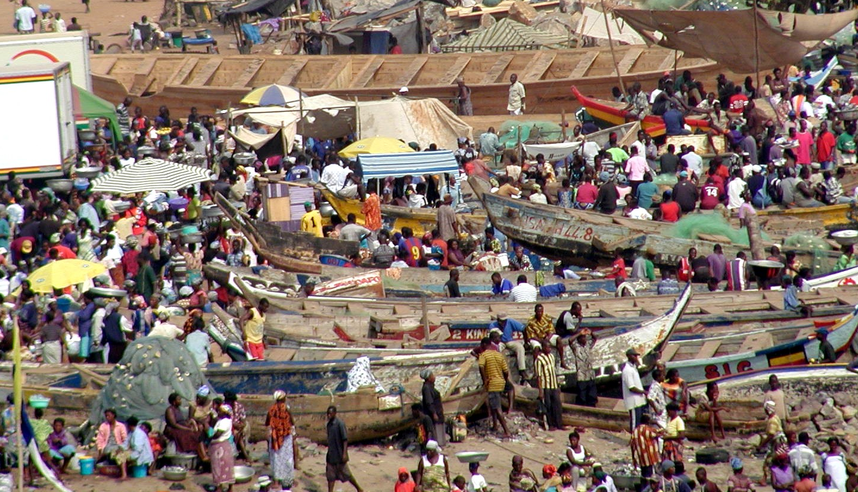

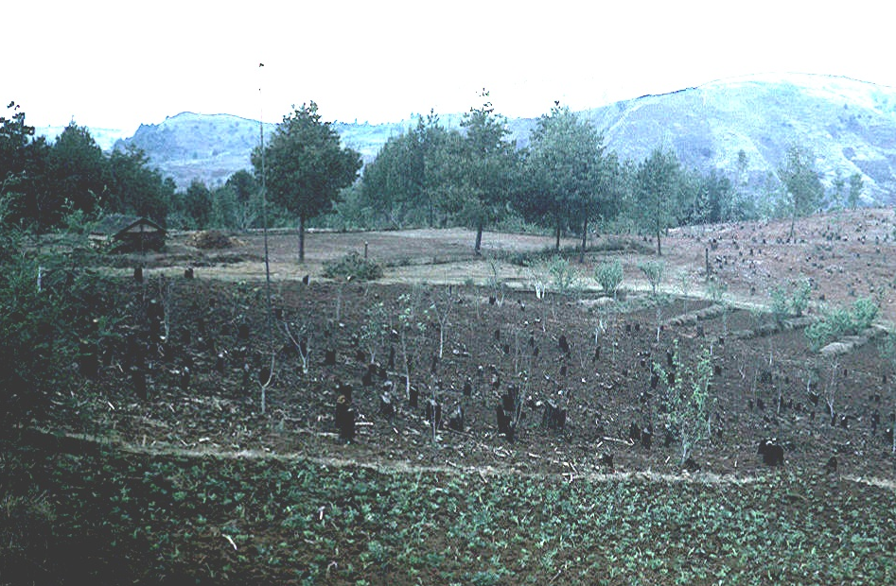
Yeah, so what?
Also instrumentally important b/c food security assoc w/ social stability and environmental protection

Slide 4
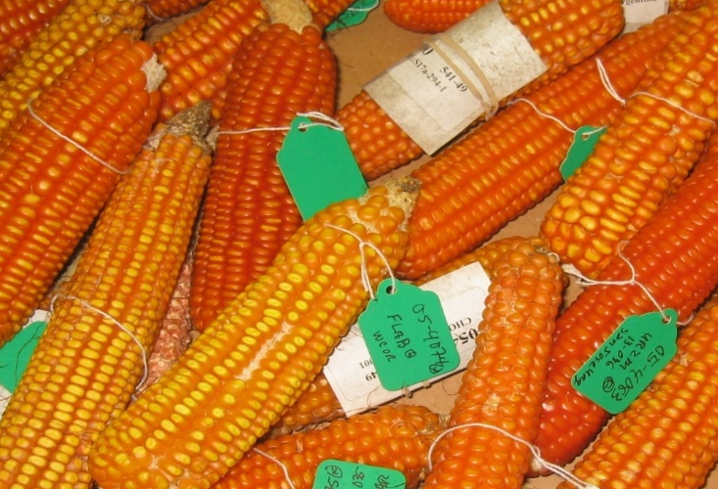
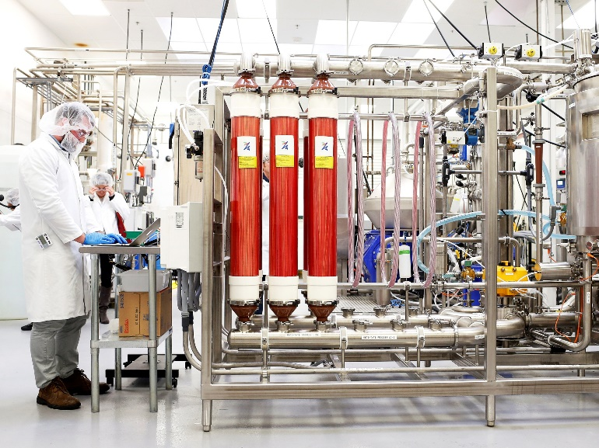
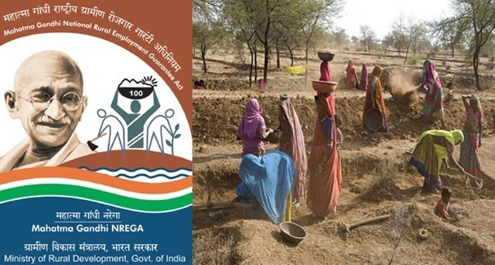
Requires a progressive agenda
Achieving global food security requires innovations that are progressive in both senses:
Have faith in science as an engine of advance
Show solidarity with the poor
Photo credits: Forward Press, Beck Diefenbach/Reuters, Mike Gore

Slide 5
2 central messages
Global food challenges are formidable but manageable. The world has previously faced and successfully tackled global food security through scientific and social protection innovations.
But challenges today are fundamentally different, so require different foci and new innovations:
  Africa (and S.Asia)
  Healthy diets: micronutrients/obesity
  De-risking agri-food systems
  De-agrarianizing food systems
  Planetary boundaries: climate, water, soils
  Policies, institutions, culture as much as tech

Slide 6
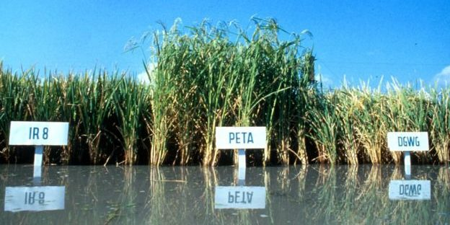
50 yrs ago, facing ‘population bomb’ and repeated famines, goal was to reduce PEM/undernourishment. Science-led effort to ‘grow the pile of rice on the plates of food-short consumers’. Ag tech of Green Revolution and Norman Borlaug NPP1970.
Past success
Photo credit: IRRI

Slide 7
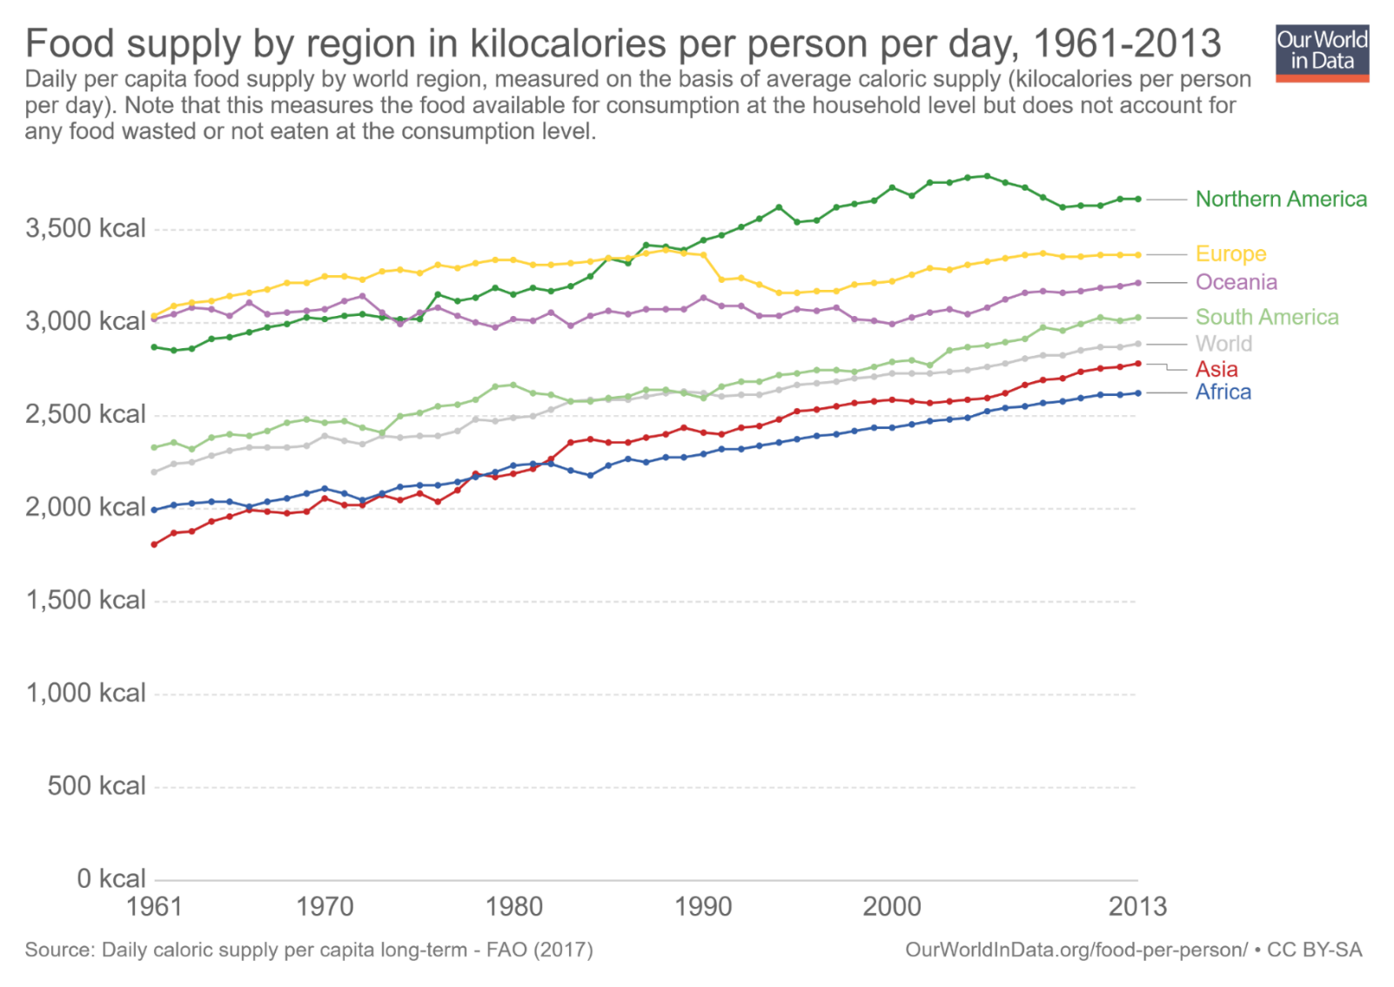
Past success
Result: Global population grew from 3.7-7.5 bn people … but staple foods supplies grew even faster.
2011-13 min. dietary energy req’t [1770,2340]

Slide 8
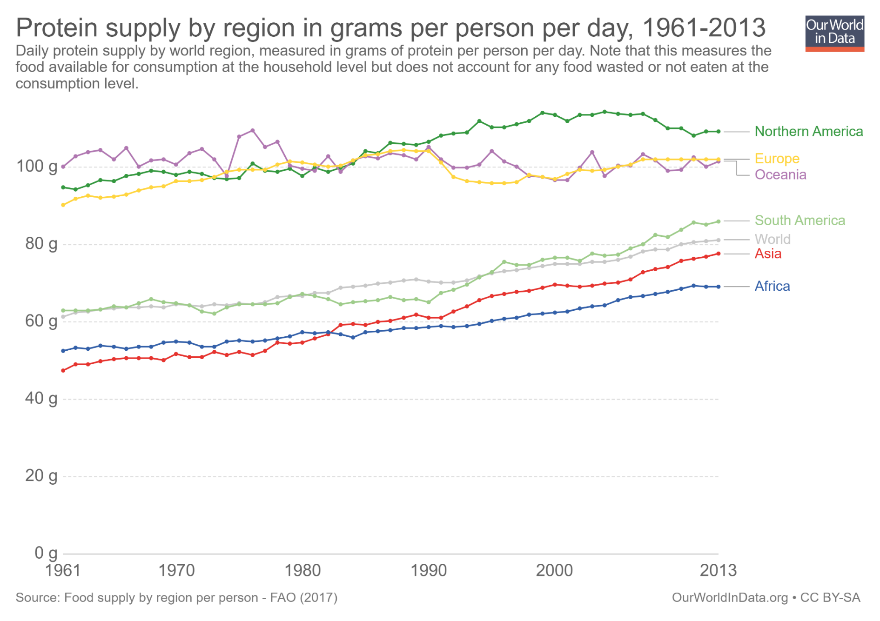
Past success
… likewise true for protein availability
Daily protein req’t:
45-55 g/day global avg
(0.8g p/kg body weight)

Slide 9
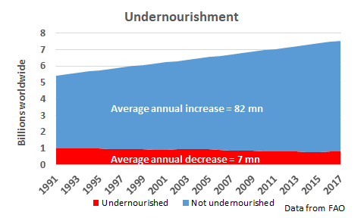
Past success
Result: ~5 bn more people get enough Kcal today. Each year for 50 years, >90 mn/yr more people have met caloric needs!

Slide 10
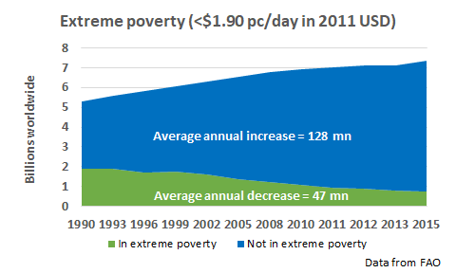
More than tech
Food systems successes enabled dramatic poverty reduction and improved standards of living
Ag R&D/policy reforms drove productivity growth, reducing real food prices. Combined w/social protection programs, lifted ~1.2 bn from poverty and undernutrition (36% to 10%). Non-poor population doubled from 3.39-6.61 bn 1990-2015!

Slide 11

More than tech
“Starvation is the characteristic of some people not having enough food to eat. It is not the characteristic of there being not enough food to eat.” (emphasis in original)
- Opening sentences, Amartya Sen, Poverty and Famines, 1981
Poverty is the key driver of food insecurity/undernutrition. Massive safety net expansion, incl. employment guarantee schemes:
130 low-/middle-income countries now have at least one non-contributory cash transfer program (Bastagli et al. ODI 2016)
~1.5 bn people benefit from gov’t food assistance programs (mostly in-kind) (Alderman et al. 2018)
Professionalized humanitarian response has dramatically improved early warning and targeting, and accelerated cost-effective response. “Food assistance” in place of “food aid”.
Photo credit: ODI

Slide 12
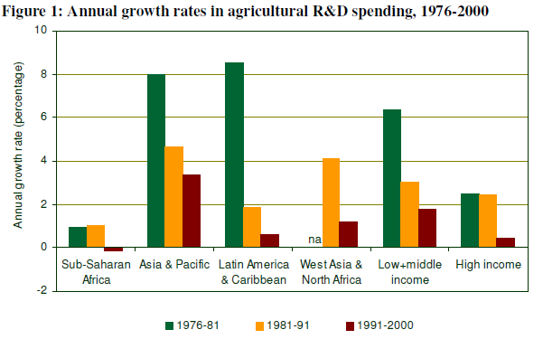
But then complacency
Success induced complacency, slowing ag R&D investments.
Source: Beintema & Elliott 2009
That’s a problem in highly adaptive agro-ecosystems … esp. when we accelerate ecosystem change.

Slide 13
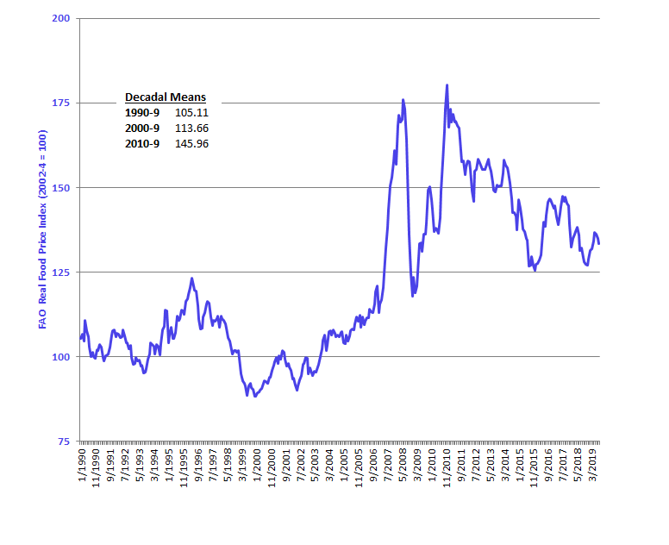
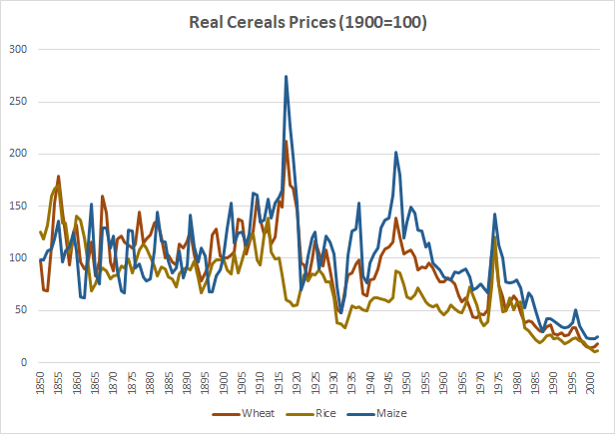
… and rising food prices
Slowing R&D + accelerating demand growth predictably led, w/ lag, to rising prices, reversing long-term real food price declines.
Most forecasts predict non-decreasing food prices over the next 10-20 yrs as demand growth > supply expansion worldwide.

Slide 14
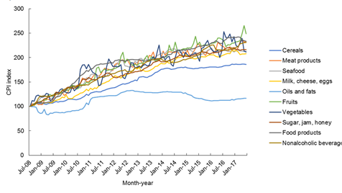
Unintended consequences
There were also major unintended consequences of 1960s-90s focus on staple cereals.
1. Increased relative price of more nutritious foods
Example: In Pakistan, fruit/veg/ASF prices have increased 2-2.5x those of oils/fats and 25-75% > cereals
(Source: Dizon & Herforth 2018 WB PRWP)

Slide 15
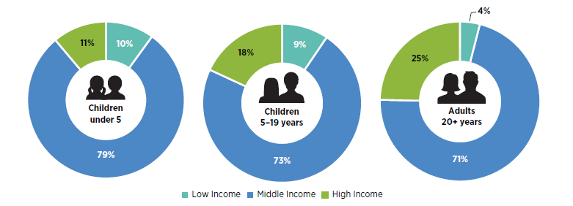
Unintended consequences
2. Growth of ultra-processed foods: cheaper sugars and fats provide low cost industrial feedstock, esp. as rising real wages rapidly boost demand for processed foods/FAFH.
This is a global problem, not just a high-income country one.
Share of world’s overweight/obese population
Source: World Bank 2020

Slide 16
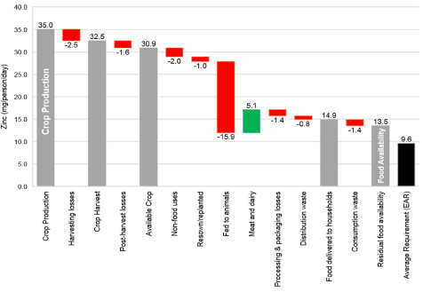
Unintended consequences
3. Cheaper food and longer supply chains increase loss/waste of key nutrients along the value chain from crop production to human consumption
Source: Ritchie et al. 2018 FSFS
For some micronutrients (calcium, folate) residual availability <10% >DRs.

Slide 17
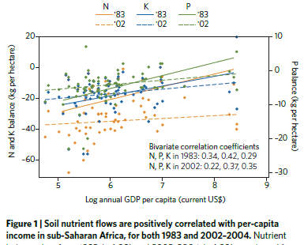
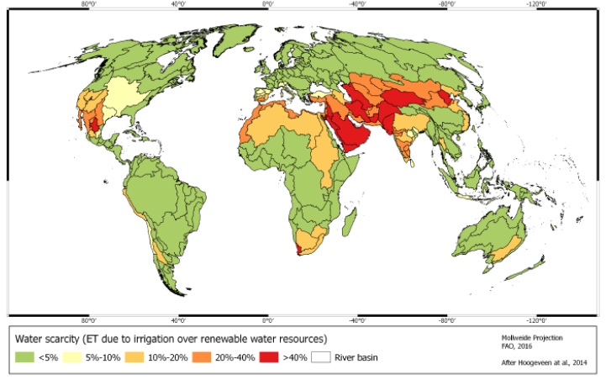
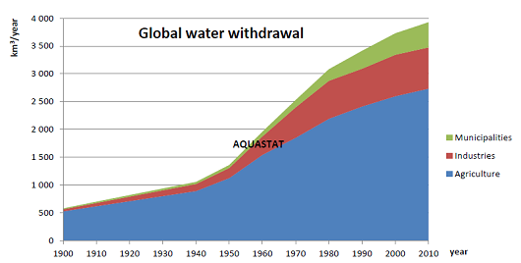
Unintended consequences
4. More agri-food production, waste, and processing overtax resources, esp. water, soils and climate
Globally, ag uses 70% of water withdrawals but >80% in Africa and Asia. Key river basins suffer serious water stress.
Ag accounts f0r 24% of GHG emissions (IPCC 2014).

Slide 18
So what now?
Clearly the challenges today differ from those 50 years ago. So innovation strategy must change too.

Slide 19

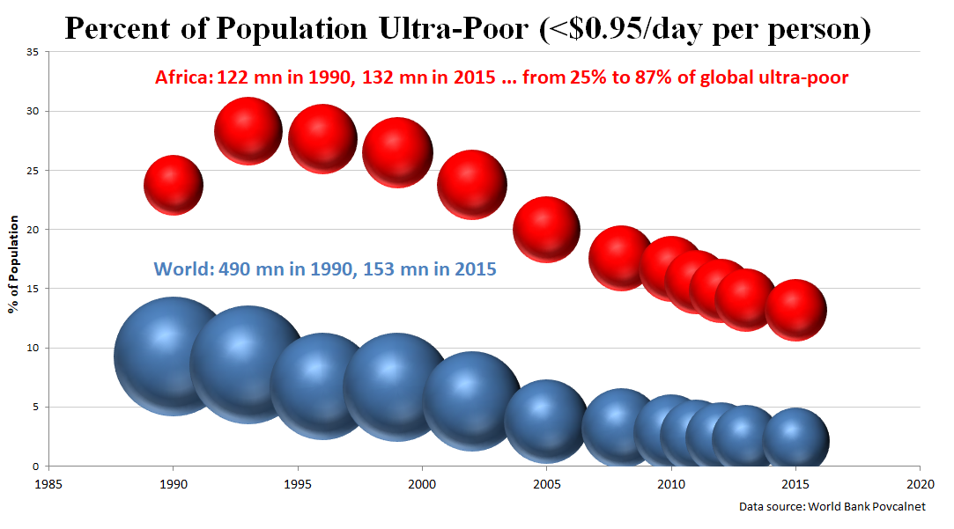
Today’s challenges
Undernutrition still, but increasingly focused where:
1. Poverty traps exist … multiple market/institutional failures lead to self-reinforcing feedback that perpetuates poverty.
Less about food security than ultra-poverty reduction and humanitarian response.

Slide 20
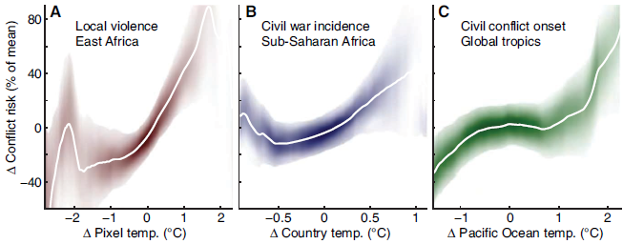
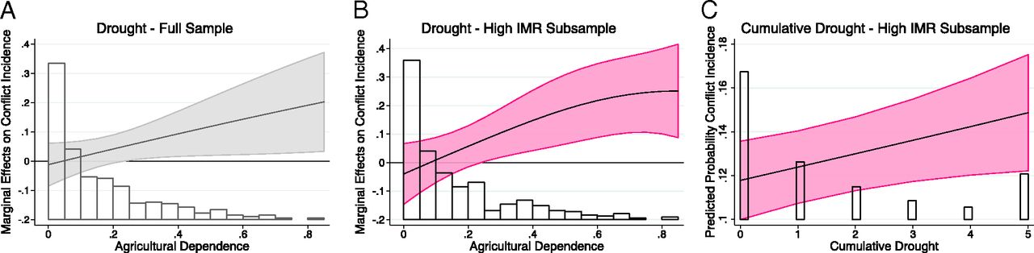
Today’s challenges
Undernutrition still, but increasingly focused where:
2. Conflict: Over past 2 decades, conflict-affected countries’ share of stunted children grew from 46% to 79% (FAO et al. 2017). A record ~71mn forcibly displaced people globally now. And strong relationship between temp, drought and conflict (Hsiang et al. 2013; von Uexkul et al. 2016).
Reducing undernutrition is now less about agri-food systems than about humanitarian response, conflict resolution, and climate change mitigation.

Slide 21
Today’s challenges
Priorities for agri-food systems innovations
Africa (and S.Asia)
Healthy diets, not expanding calorie supply
De-risking food systems
De-agrarianizing food system
Respect planetary boundaries: climate, water, soils
Policies, institutions, culture as crucial as tech

Slide 22
>70% food demand growth will occur in Africa/South Asia due to population and income growth plus urbanization.
2070 UN pop projections (Limited scope to change path):
~10.5bn (±0.75) total population
~5.2 bn in Asia (falling, 2020=4.6)
~3.3 bn in Africa (growing, 2020=1.3)
~1.3 bn in HICs (falling, 2020=1.2)
Africa (and S. Asia)

Slide 23
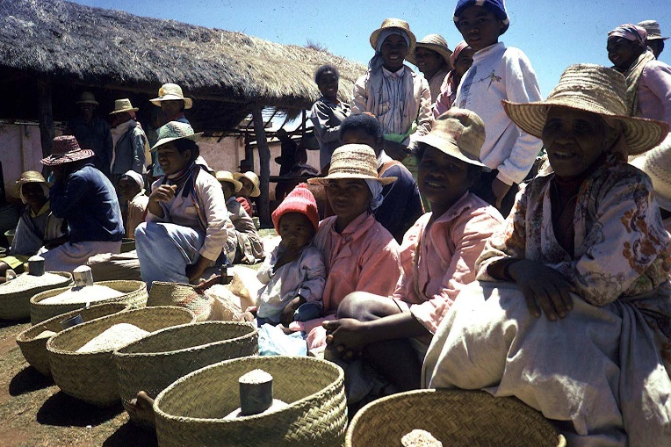
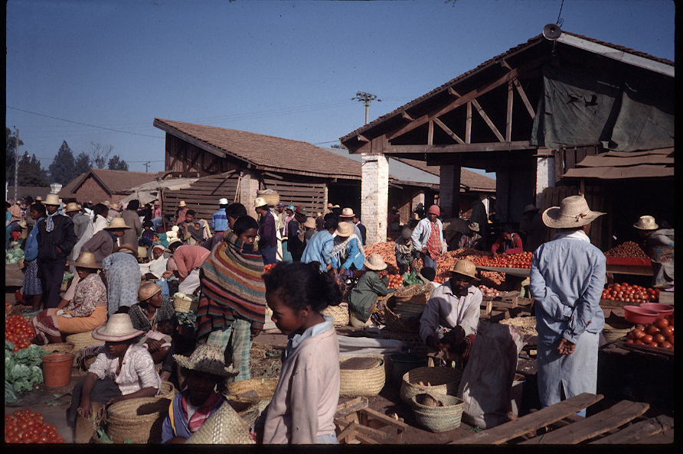
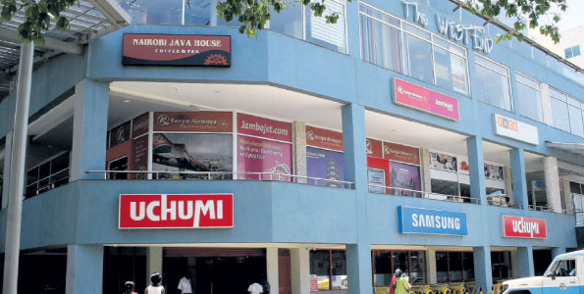
Africa (and S. Asia)
Cannot rely on trade because 70-80% of food is consumed within country where feedstock is grown.
Store photo credit: Business Daily Africa

Slide 24
Huge productivity gaps between world regions. Both need and opportunity to boost food production
Africa (and S. Asia)
Source: Fuglie et al. 2019

Slide 25
Healthy diets
Need to focus on micronutrients (“hidden hunger”)
- >2.2 bn suffer iron- or vitamin B₁₂ deficiency anemia
… and growing!
33/15% of pre-school age children/pregnant women at risk of vitamin A deficiency
zinc deficiency prevalence 40-70% in low-income Asia/Africa
Sources: FAO et al. 2017; WHO 2008, 2009, Lopez et al. Lancet 2016.
We lack rigorous estimates of pop deficient in ≥1 nutrient, likely 2.5-3.5 bn globally, 3-4x the number undernourished.
And >2 bn globally are overweight/obese.

Slide 26
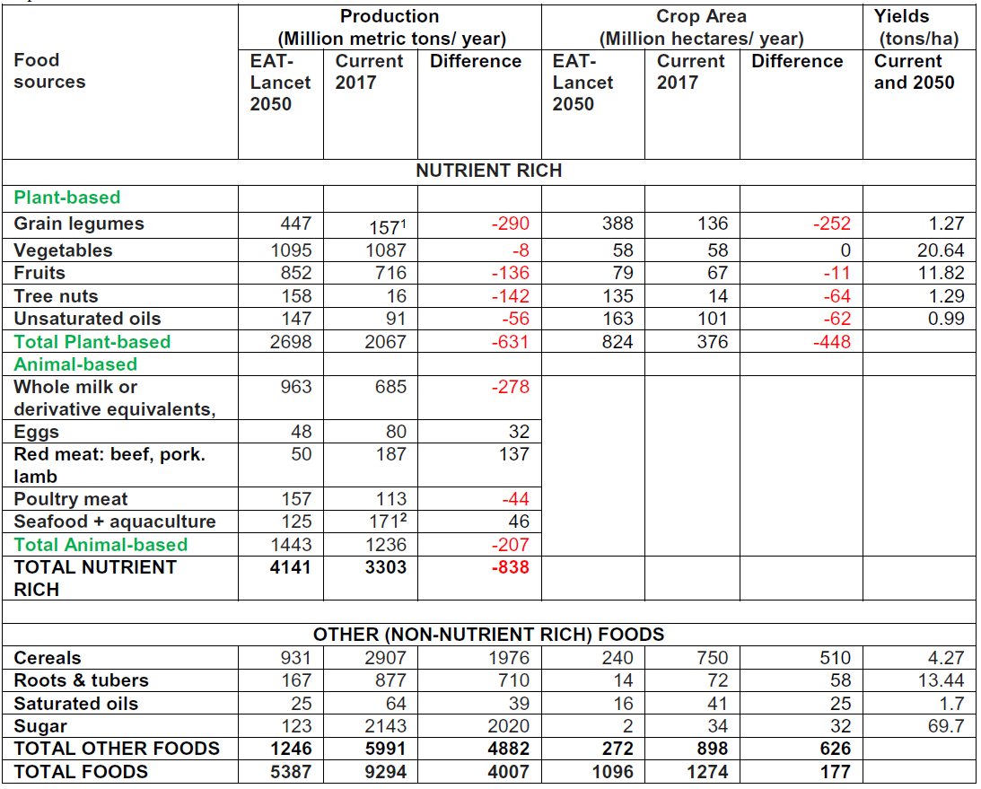
Healthy diets
Need sharp increase in R&D for nutrient-rich foods
CGIAR and most ag ministries built for 1960s-80s challenges … need to refocus on non-staple commodities.
Sanchez (2020 Food Policy) estimates land-neutral shift in farm lands can feasibly supply healthy diets.

Slide 27
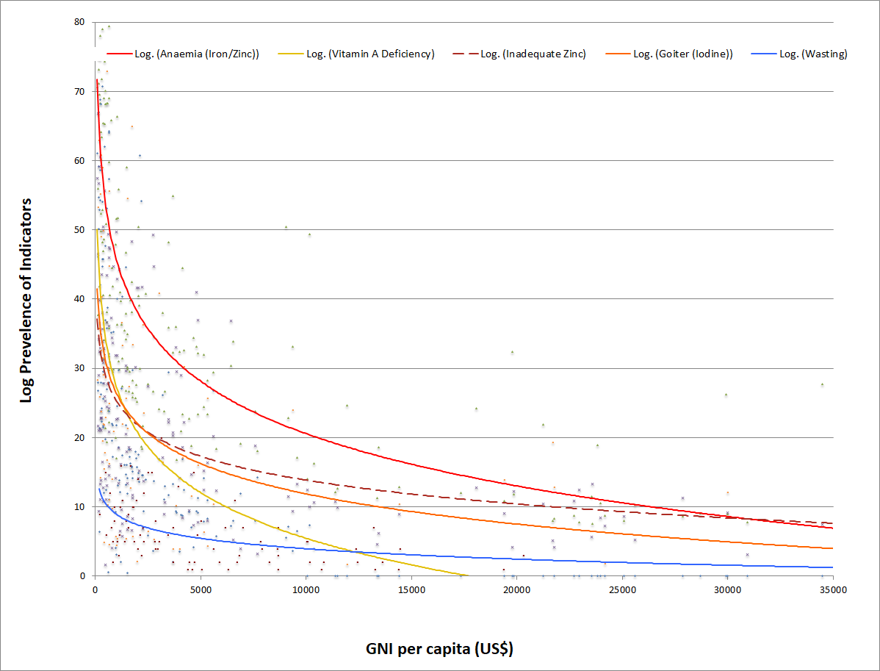
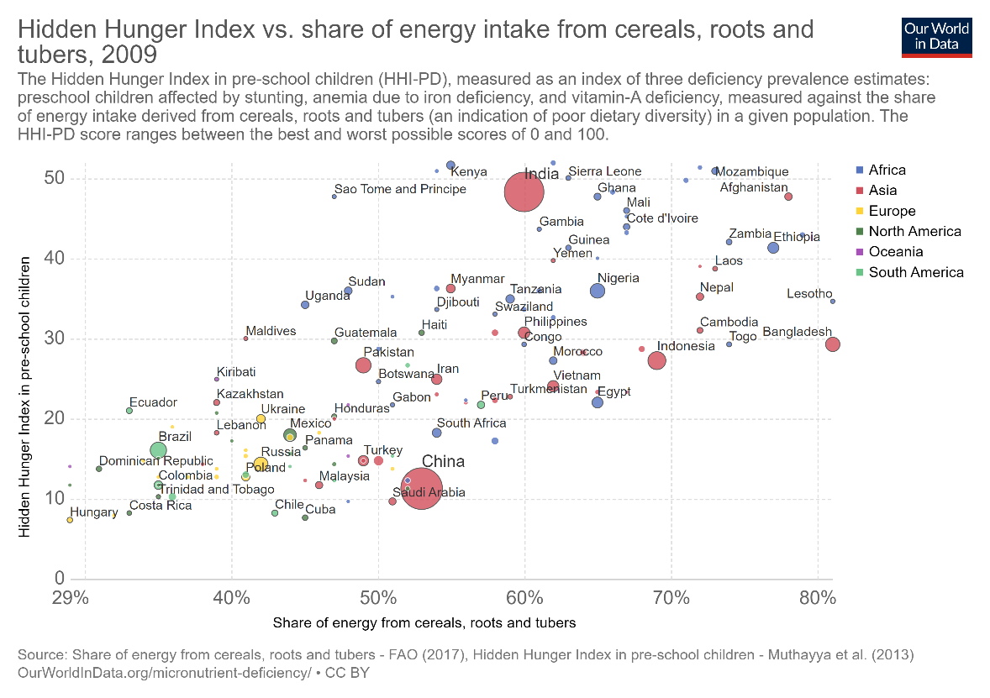
Healthy diets
Micronutrient deficiencies are less responsive than calories to income and strongly related to diet. Can’t rely on economic growth/poverty reduction alone.
Source: Barrett and Bevis, 2015

Slide 28
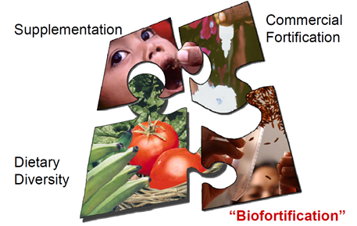
Healthy diets
Need innovations beyond farmland allocation changes:
- upstream (biofortification, mineral fertilizers/irrigation water)
- midstream (industrial fortification– iodized salt, folic acid)
- downstream (consumer behavior change)
Graphic credit: Ross Welch/Mike Gore

Slide 29
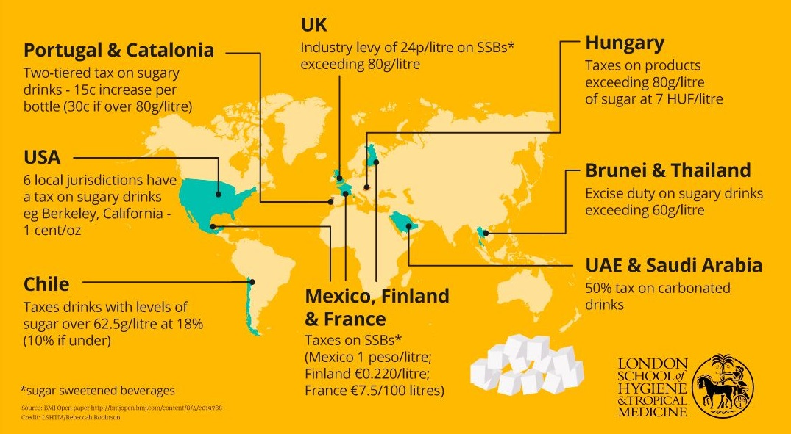
Healthy diets
Use policy to tax unhealthy (ultra-processed) foods and subsidize healthy foods to address health externalities
Growing global evidence that national-scale interventions work.
Taxes reduce intake of fats, sugars, obesity rates, and NCDs.

Slide 30
De-risking
Climate crisis, trade wars, transnational disease transmission, price spikes … risks loom larger today
New technologies can help reduce and transfer risk:
Genetic technologies: drought-resistant maize, flood-resistant rice, conversion of C3 crops (e.g., rice) to C4, etc. CRISPR and related gene editing open up new options.
Digital technologies: Price discovery, pathogen/pest detection, yield prediction, product traceability, index insurance design, etc.
Mechanical technologies: Robotics, improved storage, micro-irrigation, etc.

Slide 31

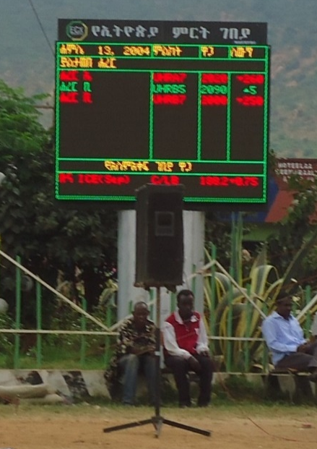
De-risking
Markets/institutions equally important
Examples:
Productive safety nets: catastrophic risk exposure reduces investment by the poor
Index insurance quality control: Insurance or lottery tickets?
Markets: ICT expands markets, stabilizes prices and reduces info asymmetries/power

Slide 32
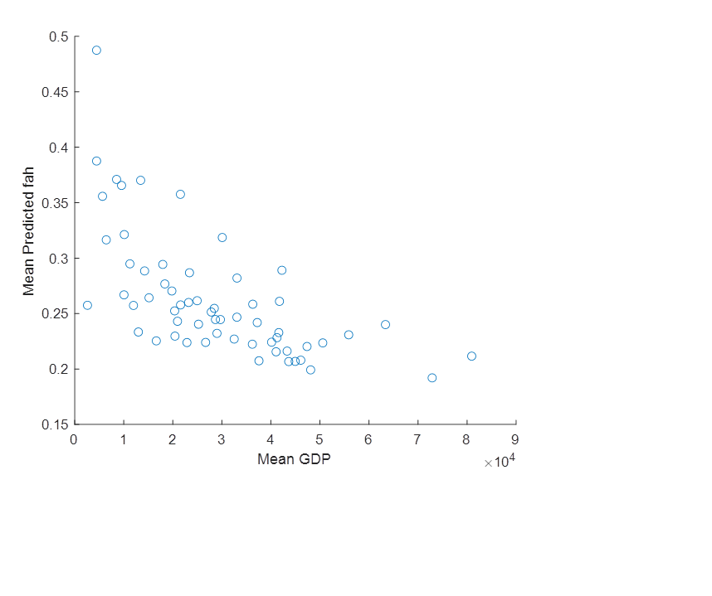
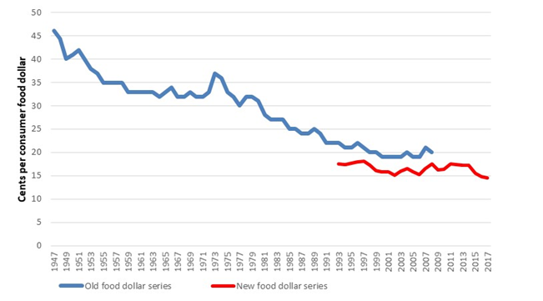
De-agrarianizing food system
As economies develop, food value addition naturally moves away from farm: processing, packaging, service, appearance, quality. Focus beyond farmgate!
Farm share as % consumer food expenditures
(US, 1947-2017, per USDA ERS)
Farm share as % consumer food expenditures (61 MHICs, 2005-15, >90% global economy)

Slide 33
De-agrarianizing food system
De-agrarianization inevitable as feedstock costs fall:
Cellular and plant-based animal product substitutes
Hydroponic, vertical, urban agriculture
Algae/insect-based livestock feeds

Slide 34
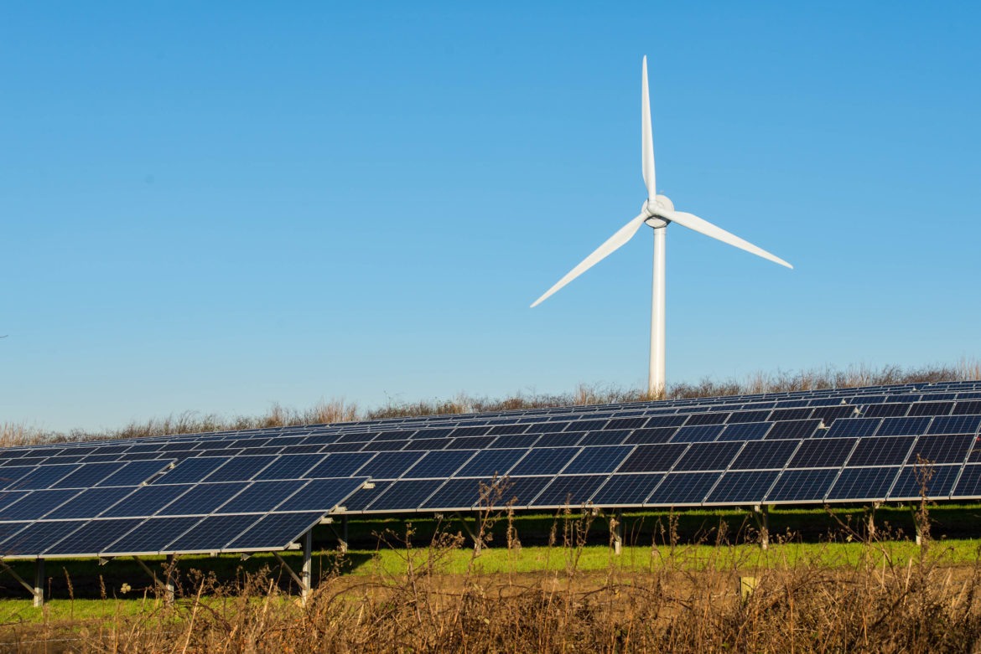
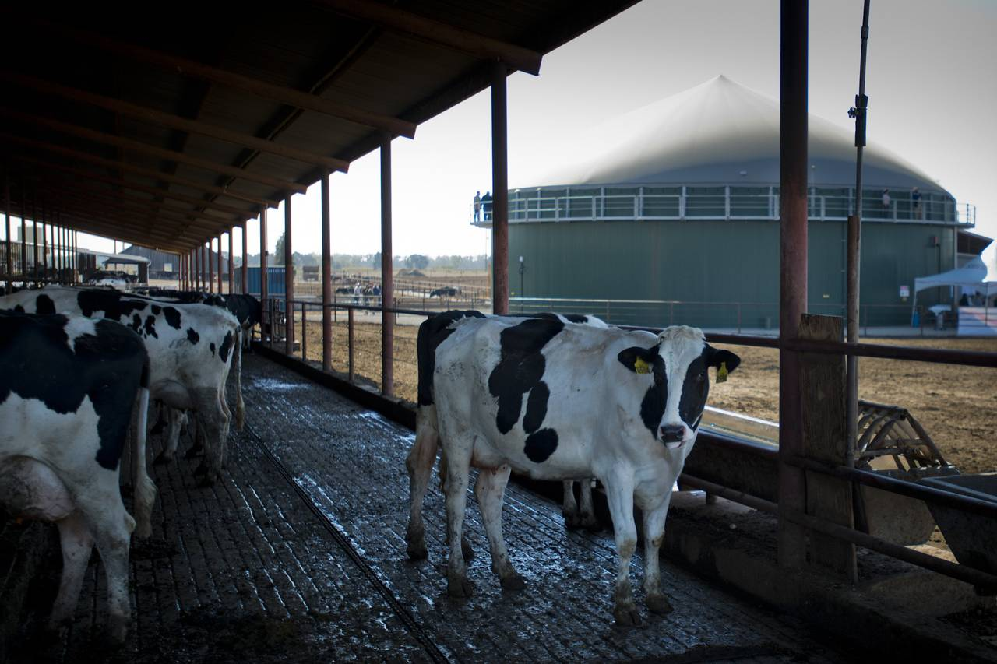
De-agrarianizing food system
Options:
1. Farmland values drop, mass rural defaults and rural poverty
2. Transition rural lands to farming carbon, methane, solar, wind. Use $700bn/yr ($1mn/min!!) in farm subsidies and create orderly carbon/methane/other markets.
“Farming” can be part of climate solution rather than problem.
Photo: Gerry Machen/Creative Commons
Photo: Manny Crisostomo/Sacramento Bee

Slide 35
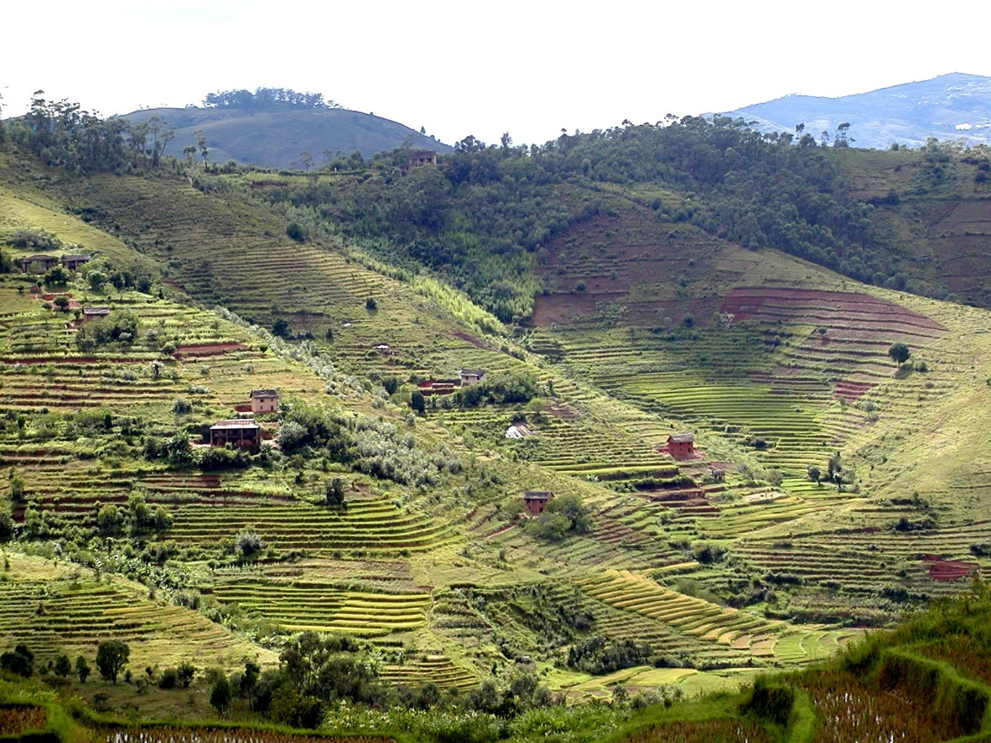
Respect planetary boundaries
Agricultural input expansion largely infeasible:
Arable land essentially fixed w/o major (ecol. risky) conversion of forest, wetlands, or drylands, esp in Asia
Increasing urban/protected area competition for land
Soil nutrient depletion (esp. N, P and minerals)
Ag already accounts for ~70% of human water usage, > 80% in Africa and Asia, climate changes makes worse
Marine capture fisheries stable or declining

Slide 36
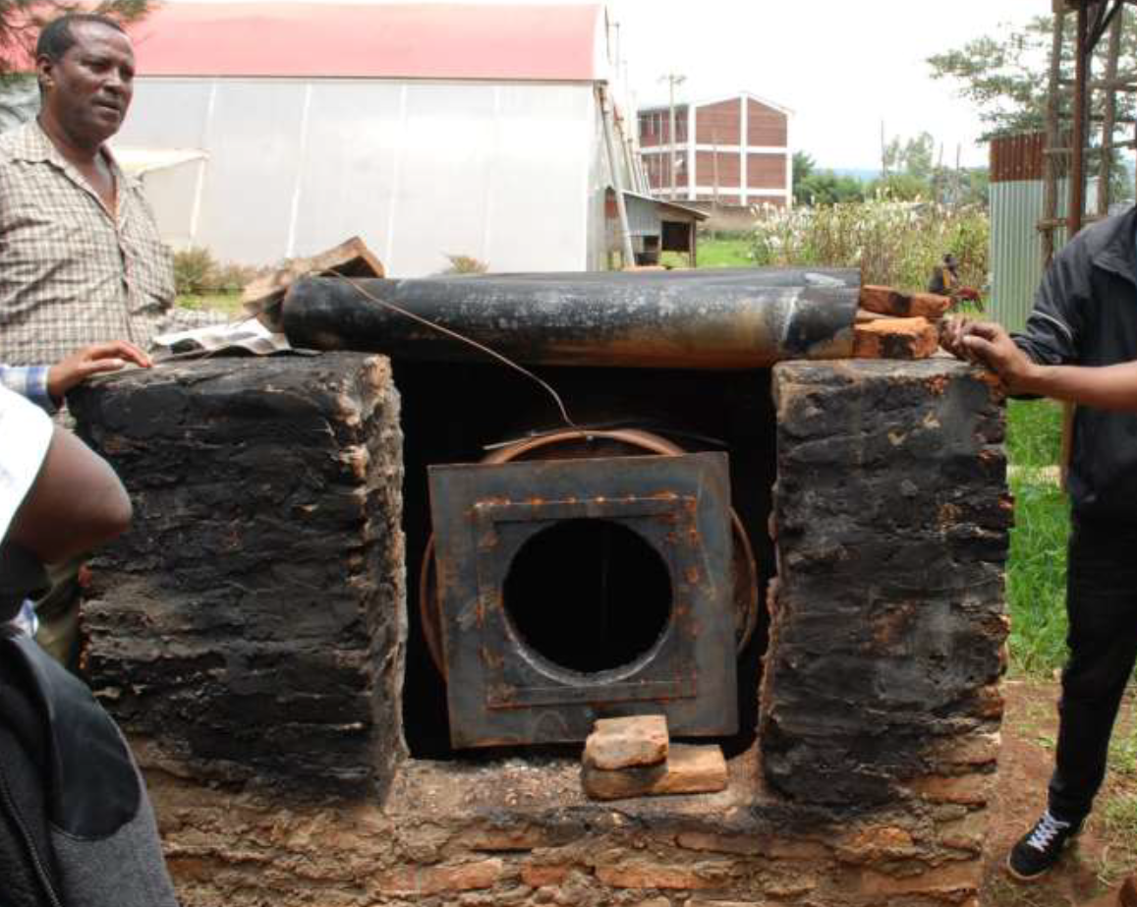
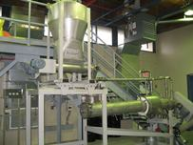
Respect planetary boundaries
Emergent tech can reduce food systems’ env’t footprint
Digital: precision ag, food rescue, monitoring of waste or encroachment into protected areas
Energy: off-grid solar/wind/biogas for improved water management and post-harvest crop drying/cooling/transport
Genetic: improved biocontrols for pests/pathogens (e.g., Bt eggplant) to reduce pesticide contamination
Mechanical: biochar/bonechar/other soil amendments to nourish soils
Cornell bonechar and village pyrolysis projects

Slide 37
Policies, institutions, culture
Tech is nec not suff. Human behavior is central … need win-win pathways to accelerate transitions.
  Incentives and institutions drive discovery and diffusion: R&D, tenure regimes, IP, STEM training …
  Agri-food R&D capacity severely limited in Africa/Asia. Need to resuscitate agri-food R&D institutions and renew investment in capacity building.
  Technological advance requires investment. Gov’ts and philanthropies essential but insufficient. Rely heavily on the private sector. B corps of growing interest.
  Private IP regimes increasingly pose obstacles.
  Opposition to GMOs/gene editing impedes progress
  Chefs/cooks as changemakers … re-shape diets or us!

Slide 38
A sustainable food secure future for all requires innovations:
1. In growing the downstream supply of minerals and vitamins from vegetables, fruits, and animal source foods
2. Accelerating adaptation to climate change, water scarcity, and improve soil nutrient cycling and climate mitigation
3. Food value chain enhancements to improve access to affordable, healthy foods, and reduce loss and waste
4. Enhanced social protection and safety nets for the poorest
5. De-risking and de-agrarianizing food systems
6. A stronger focus on and in Africa and South Asia
Science and solidarity

Slide 39

Thank you
Thank you for your time, interest and comments!

